Slide 1
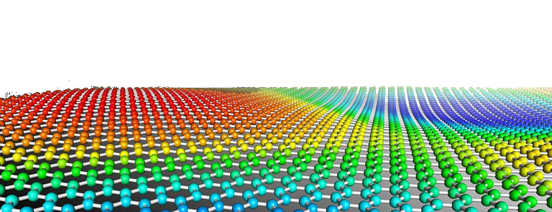
PYTHON
Prof. Muhammad Saeed

Slide 2
Symbolic Math
Python Dept. Of Comp. Sc. & IT, FUUAST

Slide 3
Symbolic Math.
import numpy as np
from sympy import *
x=Symbol('x')
y=Symbol('y')
f=Symbol('f')
print(expand((x+y)**3))
print(expand(sin(x+y), trig=True))
derf=diff(sin(x), x)
print(derf)
print(derf.subs(x,2))
print(series(cos(x), x))
print(integrate(2*x + exp(-x)sin(x), x))
print(integrate(2*x + exp(-x)sin(x), (x,pi/2,5*pi/2))
f = x**4 - 3*x**2 + 1
print(factor(f))
Python Dept. Of Comp. Sc. & IT, FUUAST

Slide 4
Symbolic Math.
from sympy import *
x,y,z=symbols(’x y z’)
limit(sin(x)/x, x, 0)
solve(x**4 - 1, x)
solve([x + 5*y - 2, -3*x + 6*y - 15], [x, y])
pprint(3*x**3-5*x**2+2*x+10)
simplify(sin(2*x) - 2*sin(x)*cos(x))
(1 + x*y).subs([(x,pi), (y,2)])
expr = x**3 + 4*x*y - z
expr.subs([(x, 2), (y, 4), (z, 0)])
expr = sqrt(8)
expr.evalf()
N(sqrt(2)*pi)
Python Dept. Of Comp. Sc. & IT, FUUAST

Slide 5
Symbolic Math.
from sympy import *
x,y,f=symbols(’x y f’)
u=solveset(Eq(x**2, 1), x)
v=solveset(Eq(x**2 - 1, 0), x)
w=solveset(x**2 - 1, x)
diffeq = Eq(f(x).diff(x, x) - 2*f(x).diff(x) + f(x), sin(x))
g=dsolve(diffeq, f(x))
r=roots(x**3 - 6*x**2 + 9*x, x)
Python Dept. Of Comp. Sc. & IT, FUUAST

Slide 6
END
Python Dept. Of Comp. Sc. & IT, FUUAST

