Slide 1
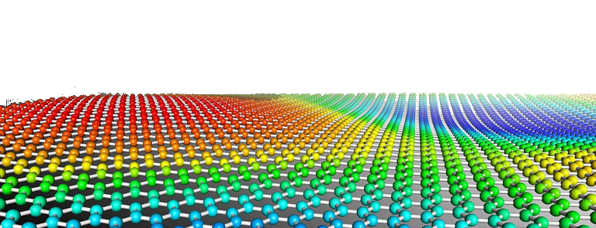
PYTHON
Prof. Muhammad Saeed

Slide 2
Programming
In
Python
Python Dept. Of Comp. Sc. & IT, FUUAST

Slide 3
Programming
Case-sensitive
Object Oriented
Every identifier is an object
Indentation replaces blocks for ‘function’, ‘If’, ‘else’, ‘elif’, ‘for’, ‘while’ etc.
First line for ‘function’, ‘If’, ‘else’, ‘elif’, ‘for’ and ‘while’ is terminated at colon(:)
Multiple assignments are allowed as x, y, z= 0,10,-3
Packages are imported into programs as:
import scipy
import scipy as sp
from scipy import *
from scipy import sin, cos, exp
Hierarchy:
Project
Package
Module
Python Dept. Of Comp. Sc. & IT, FUUAST

Slide 4
Programming input/output
print
name=‘FUUAST ’
city=‘Karach i’
print(name + ‘Gulshan Campus ’+city)
age=25;
s=2.555;
continent=‘Asia’;
nm=‘Ali’
print(‘My name is %s, my age is %d,my salary is %6.3f million pm and I live in %s’%(nm, age, s, continent))
print(age,s,nm)
print(‘\nName: {0}\nAge: {1}\nSalary: {2}\n’.format(nm,age,s))
input
n=input(‘Enter a number: ’)
sts=input(‘Enter names: ‘)
Python Dept. Of Comp. Sc. & IT, FUUAST

Slide 5
Programming escape sequences
Escape | What it does.
\\ | Backslash (\)
\' | Single-quote (')
\" | Double-quote (")
\a | ASCII bell (BEL)
\b | ASCII backspace (BS)
\f | ASCII formfeed (FF)
\n | ASCII linefeed (LF)
\N{name} | Character named name in the Unicode database (Unicode only)
\r | Carriage Return (CR)
\t | Horizontal Tab (TAB)
\uxxxx | Character with 16-bit hex value xxxx (u'' string only)
\Uxxxxxxxx | Character with 32-bit hex value xxxxxxxx (u'' string only)
\v | ASCII vertical tab (VT)
\ooo | Character with octal value ooo
\xhh | Character with hex value hh
Python Dept. Of Comp. Sc. & IT, FUUAST

Slide 6
Programming Decision & Loops
x=-1;
if x > 0:
print(‘x is positive’)
print(‘Good, keep it up’)
elif x == 0:
print(‘x is nobody’)
print(‘Be practical’)
elif x < 0:
print(‘x is negative’)
print(‘Try to be positive’)
else:
print(‘Be something’)
for i in range(1,20):
r=i%2
if r==0:
print(‘\nNumber %d is Even’%(i))
else:
print(‘\nNumber %d is Odd’%(i))
print(‘Thanks’)
Python Dept. Of Comp. Sc. & IT, FUUAST

Slide 7
Programming Loops
bigms = [‘Books',‘Internet',‘Games’,’Movies’,’Songs’]
for i in range(len(bigms)):
print("I like",bigms[i])
n = 100; sm = 0; i = 1
while i <= n:
sm = sm + i
i = i + 1
print("Sm of 1 until %d: %d" % (n,sm))
count = 0
while count < 5:
print( count, ’ is less than 5’ )
count = count + 1
else:
print( count, " is not less than 5“)
flag=1
while (flag): print( ‘Job is done‘)
Python Dept. Of Comp. Sc. & IT, FUUAST

Slide 8
Programming Nested Loops, break, continue, pass
p=np.zeros([10,5])
for n in range(10):
for m in range(5):
p[n,m]=m*n
sm=sum(sum(p))
print(p,’\n\n’,sm)
for c in ‘University':
if c == ‘v':
break
print('Current Character : ', c)
for c in ‘University':
if c == ‘v':
continue
print('Current Character : ', c)
Python Dept. Of Comp. Sc. & IT, FUUAST

Slide 9
Programming Nested Loops, break, continue, pass
for c in ‘University':
if c == ‘v':
pass
print('Current Character : ', c)
d=np.array([1,2,3,4,5,6,7,8,9,10,11,12,13,14,15,16])
y=[x**2 for x in d if x%4==0]
Python Dept. Of Comp. Sc. & IT, FUUAST

Slide 10
Programming Functions
def evenodd(n):
if (n%2==0):
print(‘\nEven’)
else:
print(‘\nOdd’)
def addsubtract(a,b):
if a>b:
return a-b
else :
return a+b
vec_addsubtract = vectorize(addsubtract)
vec_addsubtract([0,3,6,9],[1,3,5,7])
f=lambda x, y: 2*x**2-3*x*y+5*y**2+4*x-2*y+10; f(2.5, 3)
nums = [2, 18, 9, 22, 17, 24, 8, 12, 27]
flt=filter(lambda x: x % 3 == 0, nums); print(*flt)
Python Dept. Of Comp. Sc. & IT, FUUAST

Slide 11
Programming Default Arguments
def funct(x,str1='Hello',y=1,str2='Hi'):
print(x,str1,y,str2)
funct(50, str2='ASA', str1='abc', y='nn')
funct(16,’Karachi’, 200,’ Lahore’)
funct(225)
funct(25,’Quetta’)
def quote():
""“ There are no tales finer than those
created by life itself.
----------------------------------------------------------
"""
pass
print(quote.__doc__)
Special Functions: import scipy.special
sum; sumcum; prodcum;
Python Dept. Of Comp. Sc. & IT, FUUAST

Slide 12
Programming
END
Python Dept. Of Comp. Sc. & IT, FUUAST

