Slide 1
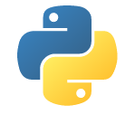
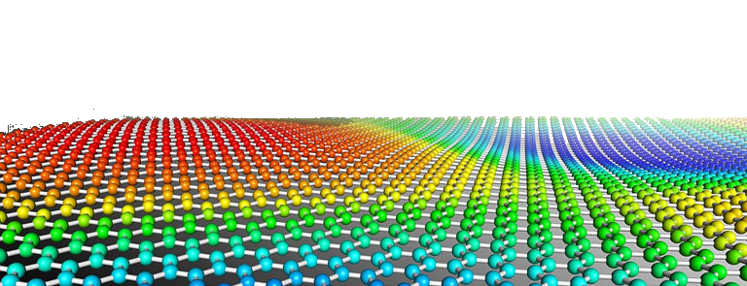
PYTHON
Prof. Muhammad Saeed

Slide 2
Differential Equations
Python Dept. Of Comp. Sc. & IT, FUUAST

Slide 3
Differential Equations
from scipy.integrate import odeint
import numpy as np
Import matplotlib.pyplot as plt
t= np.linspace(1,3,150)
y0=4.2
def yfunc(y, t):
dydt = (t**3-2*y)/t
return dydt
yf=odeint(yfunc,y0,t)
plt.plot(t,yf)
plt.show()
Python Dept. Of Comp. Sc. & IT, FUUAST

Slide 4
Differential Equations
from scipy.integrate import odeint
import matplotlib.pyplot as plt
import numpy as np
m=10; k=28; c=3
def xfn(x, t,m,k,c):
x0=x[0]
x1= x[1] #dx/dt
x2=-c/m*x[1]-k/m*x[0]
return [x1, x2] # return x1,x2
t= np.linspace(0,10,151)
sol = odeint(xfn, [0.2, 0],t,(m, k, c))
plt.plot(t, sol[:, 0], 'b', label='(t)')
plt.plot(t, sol[:, 1],’r’)
plt.legend([‘(t)’,’Derivative’]).draggable()
plt.xlabel('t’)
plt.grid()
plt.show()
t=0, x=0.2;
t=0, dx/dt=0
Python Dept. Of Comp. Sc. & IT, FUUAST

Slide 5
Differential Equations
from scipy.integrate import odeint
import numpy as np
import matplotlib.pyplot as plt
mu = 1.0
def vanderpol(X, t):
x = X[0]
y = X[1]
dxdt = mu * (x - 1./3.*x**3 - y)
dydt = x / mu
return [dxdt, dydt]
X0 = [1, 2]
t = np.linspace(0, 40, 250)
sol = odeint(vanderpol, X0, t)
x = sol[:, 0]; y = sol[:, 1]
plt.plot(t,x, t, y)
plt.xlabel('t')
plt.legend(('x', 'y')).draggable()
plt.figure()
plt.plot(x,y)
$$\frac{dx}{dt}=μ\left(x−\frac{1}{3}x^{3}−y\right), \frac{dy}{dt}=\frac{x}{μ}$$
$$x\left(0\right)=1 and y\left(0\right)=2$$
Python Dept. Of Comp. Sc. & IT, FUUAST

Slide 6
Differential Equations
from scipy.integrate import odeint
import numpy as np
import matplotlib.pyplot as plt
$$\frac{dx}{dt}=x+2y+1, \frac{dy}{dt}=−x+y+t;$$
$$x\left(0\right)=1 and y\left(0\right)=3$$
def ODEfn(xy, t):
x = xy[0]
y = xy[1]
dxdt = x+2*y+1
dydt = -x+y+t
return [dxdt, dydt]
init = [1, 3]
t = np.linspace(0, 10, 150)
sol = odeint(ODEfn, init, t)
x = sol[:, 0]; y = sol[:, 1]
plt.plot(t,x, t, y)
plt.xlabel('t')
plt.legend(('x', 'y')).draggable()
plt.figure()
plt.plot(x,y)
Python Dept. Of Comp. Sc. & IT, FUUAST

Slide 7
Interpolation & Curve-fitting
END
Python Dept. Of Comp. Sc. & IT, FUUAST

