Slide 1

Machine Learning
in Python
Scikit-learn
1
Prof. Muhammad Saeed

Slide 2
Introduction to Machine Learning
Artificial Intelligence:
“the science and engineering of making intelligent machines.”
A branch of computer science dealing with the simulation of intelligent behavior in computers.
The capability of a machine to imitate intelligent human behavior.
A computer system able to perform tasks that normally require human intelligence, such as visual perception, speech recognition, decision-making, and translation between languages.

Slide 3
Introduction to Machine Learning
Machine Learning:
A branch of artificial intelligence, concerned with the design and development of algorithms that allow computers to evolve behaviors based on empirical data.
Machine learning, a branch of artificial intelligence, concerns the construction and study of systems that can learn from data.
“field of study that gives computers the ability to learn without being explicitly programmed.”

Slide 4
Introduction to Machine Learning
Machine Learning:
Machine learning is programming computers to optimize a performance criterion using example data or past experience.
The goal of machine learning is to develop methods that can automatically detect patterns in data, and then to use the uncovered patterns to predict future data or other outcomes of interest.

Slide 5
Introduction to Machine Learning
Deep Learning:
Deep learning is a subset of machine learning. Usually, it refers to deep artificial neural networks, and somewhat less frequently to deep reinforcement learning.
Deep artificial neural networks are a set of algorithms that have set new records in accuracy for many important problems, such as image recognition, sound recognition, recommender systems, etc.

Slide 6
Introduction to Machine Learning

Slide 7
Introduction to Machine Learning
Types of Statistical Data:
Categorical
A categorical variable (sometimes called a nominal variable) is one that has two or more categories, but there is no intrinsic ordering to the categories. For example, gender is a categorical variable having two categories (male and female) and there is no intrinsic ordering to the categories. Hair color is also a categorical variable having a number of categories (blonde, brown, brunette, red, etc.)
Ordinal
An ordinal variable is similar to a categorical variable. The difference between the two is that there is a clear ordering of the variables. For example, suppose you have a variable, economic status, with three categories (low, medium and high). In addition to being able to classify people into these three categories, you can order the categories as low, medium and high.

Slide 8
Introduction to Machine Learning
Types of Statistical Data:
Interval
An interval variable is similar to an ordinal variable, except that the intervals between the values of the interval variable are equally spaced. For example, suppose you have a variable such as temperature that is measured in centigrade, and we have four temperatures 80º, 70º, 60º, 50º. The difference between values or size of interval is the same.
Ratio
A ratio variable, has all the properties of an interval variable, and also has a clear definition of 0.0. When the variable equals 0.0, there is none of that variable. Variables like height, weight, are ratio variables. Temperature, expressed in F or C, is not a ratio variable. A temperature of 0.0 on either of those scales does not mean 'no heat'. However, temperature in Kelvin is a ratio variable, as 0.0 Kelvin really does mean 'no heat

Slide 9
Introduction to Machine Learning
Supervised Learning:
  Supervised Learning is the machine learning task of inferring a function from supervised training data. The training data consist of a set of training examples. In supervised learning, each example is a pair consisting of an input object (typically a vector) and a desired output value (also called the supervisory signal).
  Classification: Samples belong to two or more classes and we want to learn from already labeled data how to predict the class of unlabeled data
categories. Another way to think of classification is as a discrete (as opposed to continuous) form of supervised learning where one has a limited number of categories and for each of the n samples provided,
one is to try to label them with the correct category or class.
Regression: If the desired output consists of one or more continuous variables, then the task is called regression. An example of a regression problem would be the prediction of the length of a salmon as a
function of its age and weight.

Slide 10
Introduction to Machine Learning
Unsupervised Learning:
Unsupervised learning, in which the training data consists of a set of input vectors x without any corresponding target values.
The goal in such problems may be to discover groups of similar examples within the data, where it is called clustering, or to determine the distribution of data within the input space, known as density estimation, or to project the data from a high-dimensional space down to two or three dimensions for the purpose of Visualization.

Slide 11
Introduction to Machine Learning
Training Set and Testing Set:
Cross Validation
Machine learning is about learning some properties of a data set and applying them to new data. This is why a common practice in machine learning to evaluate an algorithm is to split the data at hand into two sets, one that we call the training set on which we learn data properties and one that we call the testing set on which we test these
properties.
Holdout Method
The holdout method is the simplest kind of cross validation. The data set is separated into two sets, called the training set and the testing set. The function approximator fits a function using the training set only. Then the function approximator is asked to predict the output values for the data in the testing set. The errors it makes are accumulated as before to give the mean absolute test set error, which is used to evaluate the model.

Slide 12
Introduction to Machine Learning
Training Set and Testing Set:
K-fold Cross Validation
It is one way to improve over the holdout method. The data set is divided into k subsets, and the holdout method is repeated k times. Each time, one of the k subsets is used as the test set and the other k- 1 subsets are put together to form a training set. Then the average error across all k trials is computed. Every data point gets to be in a test set exactly once, and gets to be in a training set k-1 times. The variance of the resulting estimate is reduced as k is increased. The disadvantage of this method is it takes k times as much computation to make an evaluation.
Leave-one-out cross validation
With K equal to N, the number of data points in the set. That means that N separate times, the function approximator is trained on all the data except for one point and a prediction is made for that point. As before the average error is computed and used to evaluate the model. The evaluation error is good, but at first pass it seems very expensive to compute.

Slide 13
Introduction to Machine Learning

Slide 14
Introduction to Machine Learning
Models:
Linear Regression
Logistic Regression
Decision Tree
SVM
Naive Bayes
kNN
K-Means
Random Forest
Dimensionality Reduction Algorithms
Gradient Boosting algorithms
  GBM
  XGBoost
  LightGBM
  CatBoost

Slide 15
Introduction to Machine Learning
Libraries:
import pandas
from pandas.tools.plotting import scatter_matrix
import matplotlib.pyplot as plt
from sklearn import model_selection
from sklearn.metrics import classification_report
from sklearn.metrics import confusion_matrix
from sklearn.metrics import accuracy_score
from sklearn.linear_model import LogisticRegression
from sklearn.tree import DecisionTreeClassifier
from sklearn.neighbors import KNeighborsClassifier
from sklearn.discriminant_analysis import LinearDiscriminantAnalysis
from sklearn.naive_bayes import GaussianNB
from sklearn.svm import SVC

Slide 16
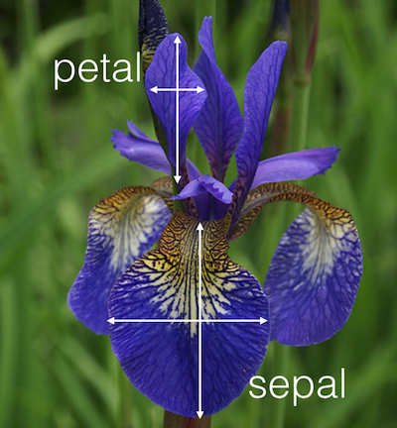
Supervised Machine Learning
Datasets:
import numpy as np
from sklearn import datasets
iris = datasets.load_iris()
dta=iris.data
r , c = dta.shape
trgt=iris.target
Print Options:
print(iris.data)
np.set_printoptions(threshold=nan)
print(iris.data)
np.set_printoptions(threshold=100000)
np.set_printoptions(precision=3)
print(iris.data)

Slide 17
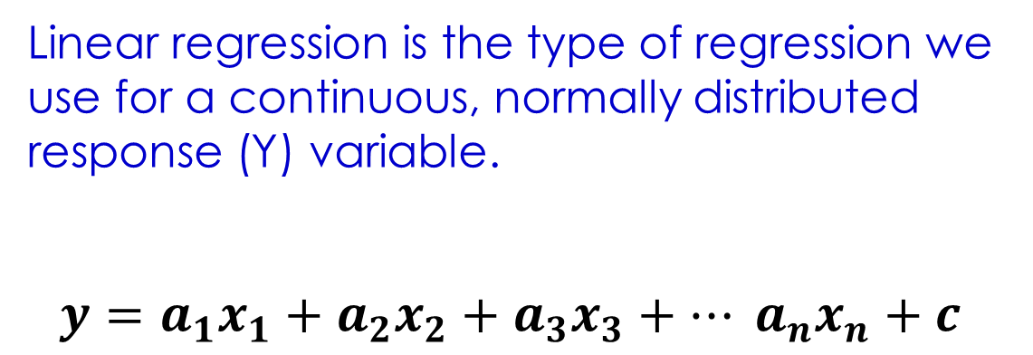
Supervised Machine Learning
Linear Regression:
Linear regression is the type of regression we use for a continuous, normally distributed response (Y) variable.
$$y=a_{1}x_{1}+a_{2}x_{2}+a_{3}x_{3}+… a_{n}x_{n}+c$$

Slide 18
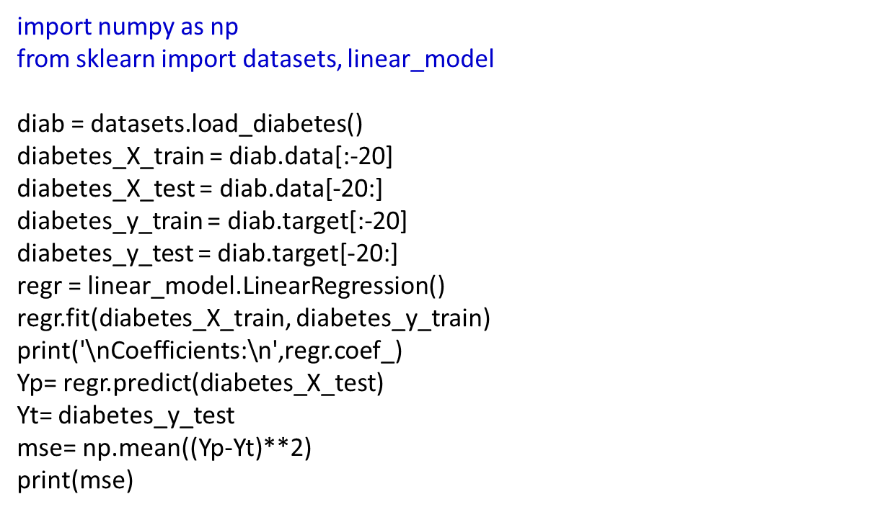
Supervised Machine Learning
Linear Regression:
import numpy as np
from sklearn import datasets, linear_model
diab = datasets.load_diabetes()
diabetes_X_train = diab.data[:-20]
diabetes_X_test = diab.data[-20:]
diabetes_y_train = diab.target[:-20]
diabetes_y_test = diab.target[-20:]
regr = linear_model.LinearRegression()
regr.fit(diabetes_X_train, diabetes_y_train)
print('\nCoefficients:\n',regr.coef_)
Yp= regr.predict(diabetes_X_test)
Yt= diabetes_y_test
mse= np.mean((Yp-Yt)**2)
print(mse)

Slide 19
Supervised Machine Learning
Ridge Regression:
Tikhonov regularization, L2 Regularization
Ridge Regression is a technique for analyzing multiple regression data that suffer from multicollinearity(Multicollinearity, is the existence of near-linear relationships among the independent variables.) When multicollinearity occurs, least squares estimates are unbiased, but their variances are large so they may be far from the true value. By adding a degree of bias to the regression estimates, ridge regression reduces the standard errors. It is hoped that the net effect will be to give estimates that are more reliable
Ridge regression addresses some of the problems of Ordinary Least Squares by imposing a penalty on the size of coefficients.
The ridge coefficients minimize a penalized residual sum of squares.

Slide 20
Supervised Machine Learning
Ridge Regression:
import numpy as np
import matplotlib.pyplot as plt
from sklearn import linear_model
X = 1. / (np.arange(1, 11) + np.arange(0, 10)[:, np.newaxis])
y = np.ones(10)
n_alphas = 200
alphas = np.logspace(-10, -2, n_alphas)
coefs = []
for a in alphas:
ridge = linear_model.Ridge(alpha=a, fit_intercept=False)
ridge.fit(X, y)
coefs.append(ridge.coef_)
ax = plt.gca()

Slide 21
Supervised Machine Learning
Ridge Regression:
ax.plot(alphas, coefs)
ax.set_xscale('log')
ax.set_xlim(ax.get_xlim()[::-1]) # reverse axis
plt.xlabel('alpha')
plt.ylabel('weights')
plt.title('Ridge coefficients as a function of the regularization')
plt.axis('tight')
plt.show()

Slide 22

Supervised Machine Learning
LASSO Regression:
L1 Regularization
LASSO stands for Least Absolute Shrinkage and Selection Operator.
It adds a factor of sum of absolute value of coefficients in the optimization objective.
Objective = RSS + α * (sum of absolute value of coefficients)
Here, α (alpha) works similar to that of ridge and provides a trade-off between balancing RSS and magnitude of coefficients. Like that of ridge, α can take various values. Lets iterate it here briefly:
α = 0: Same coefficients as simple linear regression
α = ∞: All coefficients zero (same logic as before)
0 < α < ∞: coefficients between 0 and that of simple linear regression

Slide 23
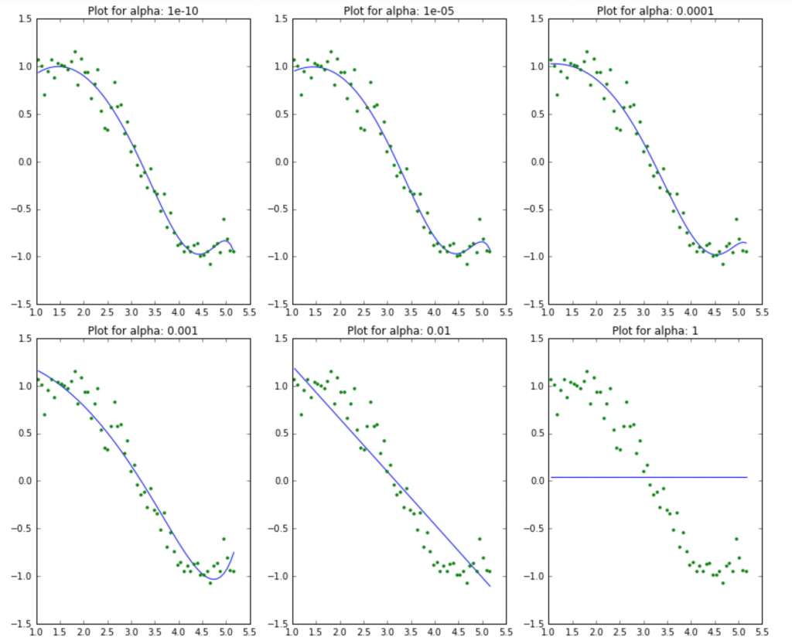
Supervised Machine Learning
Lasso Regression:

Slide 24
Supervised Machine Learning
Lasso Regression:
from sklearn import linear_model
import numpy as np
clf = linear_model.Lasso(alpha=0.0001)
clf.fit([[0,0,0], [0, 0,1], [0, 1,0],[1,0,0]], [0, 1, 2,4])
print(clf.coef_)
print(clf.intercept_)
Y=clf.predict([[0,1,1]])
print(np.around(Y))

Slide 25
Supervised Machine Learning
Ridge and Lasso Regression:
Ridge: It includes all (or none) of the features in the model. Thus, the major advantage of ridge regression is coefficient shrinkage and reducing model complexity.
Lasso: Along with shrinking coefficients, lasso performs feature selection as well. Some of the coefficients become exactly zero, which is equivalent to the particular feature being excluded from the model.

Slide 26

Supervised Machine Learning
Logistic Regression:
Logistic regression is the type of regression we use for a response variable (Y) that follows a binomial distribution
Binomial probability density function (pdf):
$$P\left(Y=y\right)=\left(\begin{aligned}&n \\ &y\end{aligned}\right)p^{y}{\left(1−p\right)}^{n−y}$$
The response (Y) is NOT normally distributed
The model must produce predicted/fitted probabilities that are between 0 and 1

Slide 27
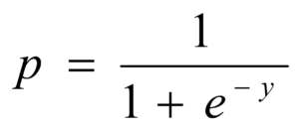
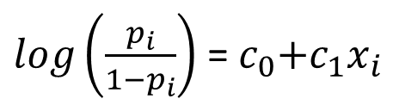

Supervised Machine Learning
Logistic Regression:
The important assumptions of the logistic regression model include:
  Target variable is binary
  Predictive features are interval (continuous) or categorical
  Features are independent of one another
  Sample size is adequate
$$y_{i}=c_{0}+c_{1}x_{i}$$
$log\left(\frac{p_{i}}{1−p_{i}}\right)$ =${ c}_{0}+c_{1}x_{i}$
, Sigmoid Function

Slide 28
Supervised Machine Learning
Logistic Regression:
from sklearn.datasets import load_iris
from sklearn.linear_model import LogisticRegression
iris = load_iris()
x, y = iris.data[:-1,:], iris.target[:-1]
logistic = LogisticRegression()
logistic.fit(x,y)
test_x = iris.data[-1,:]
test_y = iris.target[-1:]
yp = logistic.predict([test_x])
p=logistic.predict_proba([test_x])
print('Predicted class %d, real class %d'%( yp,test_y))
print('Probabilities for each class from 0 to 2: ‘,p)

Slide 29
Supervised Machine Learning
Support Vector Machines:
Support vector machines (SVMs) are a set of supervised learning methods used for classification, regression and outliers detection.
The advantages of support vector machines:
  Effective in high dimensional spaces.
  Still effective in cases where number of dimensions is greater than the number of samples.
  Uses a subset of training points in the decision function (called support vectors), so it is also memory efficient.
  Versatile: different Kernel functions can be specified for the decision function. Common kernels are provided, but it is also possible to specify custom kernels.
The disadvantages of support vector machines:
  If the number of features is much greater than the number of samples, avoid over-fitting in choosing Kernel functions and regularization term is crucial.
  SVMs do not directly provide probability estimates, these are calculated using an expensive five-fold cross-validation

Slide 30
Supervised Machine Learning
Support Vector Machines:
True Positives (TP) - These are the correctly predicted positive values which means that the value of actual class is yes and the value of predicted class is also yes.
True Negatives (TN) - These are the correctly predicted negative values which means that the value of actual class is no and value of predicted class is also no.
False Positives (FP) – When actual class is no and predicted class is yes.
False Negatives (FN) – When actual class is yes but predicted class is no.

Slide 31
Supervised Machine Learning
Support Vector Machines:
Accuracy - Accuracy is the most intuitive performance measure and it is simply a ratio of correctly predicted observation to the total observations.
Accuracy = TP+TN/(TP+FP+FN+TN)
Precision - Precision is the ratio of correctly predicted positive observations to the total predicted positive observations.
Precision = TP/(TP+FP)
Recall - The recall is intuitively the ability of the classifier to find all the positive samples.
Recall = TP / (TP+FN)
F1 score - F1 Score is the weighted average of Precision and Recall. Therefore, this score takes both false positives and false negatives into account. Intuitively it is not as easy to understand as accuracy, but F1 is usually more useful than accuracy.
F1 Score = 2*(Recall * Precision) / (Recall + Precision)

Slide 32
Supervised Machine Learning
Support Vector Machine:
import numpy as np
import matplotlib.pyplot as plt
from sklearn import datasets, svm
from sklearn.metrics import confusion_matrix, classification_report, accuracy_score
iris = datasets.load_iris()
X = iris.data
y = iris.target
n_sample = len(X)
ker=['linear','poly','rbf']
np.random.seed(0)
order = np.random.permutation(n_sample)
X = X[order]
y = y[order].astype(np.float)

Slide 33
Supervised Machine Learning
Support Vector Machine:
X_train = X[:int(.8 * n_sample)]
y_train = y[:int(.8 * n_sample)]
X_test = X[int(.8 * n_sample):]
y_test = y[int(.8 * n_sample):]
i=2
clf = svm.SVC(kernel=ker[i], gamma='auto')
clf.fit(X_train, y_train)
y_predicted=clf.predict(X_test)
#print('\n',y_test,'\n',y_predicted,'\n')
print('\nClassification Report(%s):\n'%(ker[i]), classification_report(y_test, y_predicted,target_names=['setosa','versicolor','virginica']))
print('\nConfusion Matrix(%s):\n'%(ker[i]),confusion_matrix(y_test,y_predicted))
print('\nAccuracy Score(%s):\n)'%(ker[i]),accuracy_score(y_test,y_predicted))

Slide 34
Introduction to Machine Learning
Confusion Matrix:
If a classification system has been trained to distinguish between cats, dogs and rabbits, a confusion matrix will summarize the results of testing the algorithm for further inspection. Assuming a sample of 27 animals — 8 cats, 6 dogs, and 13 rabbits, the resulting confusion matrix could look like the table below:
In this confusion matrix, of the 8 actual cats, the system predicted that three were dogs, and of the six dogs, it predicted that one was a rabbit and two were cats.
 |  | Predicted
 |  | Cat | Dog | Rabbit
Actual class | Cat | 5 | 3 | 0
 | Dog | 2 | 3 | 1
 | Rabbit | 0 | 2 | 11

Slide 35
Seaborn:
import seaborn as sns
sns.set()
iris=sns.load_dataset(‘iris’)
print(iris.head()) #iris.tail()
s=iris.shape
print(s)
sns.pairplot(iris,hue='species',size=1.5)
iris_x=iris.drop('species', axis=1)
print(iris_x.shape)

Slide 36
Supervised Machine Learning
from sklearn.model_selection import train_test_split
from sklearn.datasets import load_iris
from sklearn.metrics import confusion_matrix, accuracy_score
import seaborn as sns
from sklearn import svm
import matplotlib.pyplot as plt
iris=load_iris()
xtrain,xtest,ytrain,ytest=train_test_split(iris['data'], iris['target'], random_state=0,test_size=0.25) #train_size=
clf = svm.SVC()
clf.fit(xtrain,ytrain)
ypredict=clf.predict(xtest)
mat=confusion_matrix(ytest,ypredict)
acr=accuracy_score(ytest,ypredict)
sns.heatmap(mat, annot=True, square=True, cbar=False)
plt.xlabel('predicted value:')
plt.ylabel('true value:')
print('\nAccuracy Score: \n', acr)

Slide 37
Supervised Machine Learning
Seaborn, Confusion Matrix, Accuracy Score:
from sklearn import svm
from sklearn import datasets
from sklearn.metrics import confusion_matrix, accuracy_score
import seaborn as sns
import matplotlib.pyplot as plt
digits=datasets.load_digits()
#print(digits.data.shape())
clf = svm.SVC(gamma=0.001)
clf.fit(digits.data[:1000], digits.target[:1000])
predicted=clf.predict(digits.data[1000:])
mat=confusion_matrix(digits.target[1000:],predicted)
acr=accuracy_score(digits.target[1000:],predicted)
sns.heatmap(mat, annot=True, square=True, cbar=False)
plt.xlabel('predicted_value')
plt.ylabel('true value:')
print('\nAccuracy Score: \n', acr)

Slide 38
Supervised Machine Learning
Decision Tree:
Decision Trees or CART (Classification and Regression Trees)are a non-parametric supervised learning method used for classification and regression. The goal is to create a model that predicts the value of a target variable by learning simple decision rules inferred from the data features.
Advantages of CART
Simple to understand, interpret, visualize.
Decision trees implicitly perform variable screening or feature selection.
Can handle both numerical and categorical data. Can also handle multi-output problems.
Decision trees require relatively little effort from users for data preparation.
Nonlinear relationships between parameters do not affect tree performance.

Slide 39
Supervised Machine Learning
Decision Tree:
Disadvantages of CART
Decision-tree learners can create over-complex trees that do not generalize the data well. This is called overfitting.
Decision trees can be unstable because small variations in the data might result in a completely different tree being generated. This is called variance, which needs to be lowered by methods like bagging and boosting.
Greedy algorithms cannot guarantee to return the globally optimal decision tree. This can be mitigated by training multiple trees, where the features and samples are randomly sampled with replacement.
Decision tree learners create biased trees if some classes dominate. It is therefore recommended to balance the data set prior to fitting with the decision tree.

Slide 40
Supervised Machine Learning
Decision Tree:

Slide 41
Supervised Machine Learning
Supervised Machine Learning
Decision Tree:
Entropy is degree of randomness of elements or in other words it is measure of impurity
Example:
If we have items as number of dice face occurrence in a throw event as 1123,
the entropy is
p(1) = 0.5
p(2) = 0.25
p(3) = 0.25
entropy = - (0.5 * log(0.5)) - (0.25 * log(0.25)) -(0.25 * log(0.25) = 0.45

Slide 42
Supervised Machine Learning
Decision Tree:
Example:

Slide 43
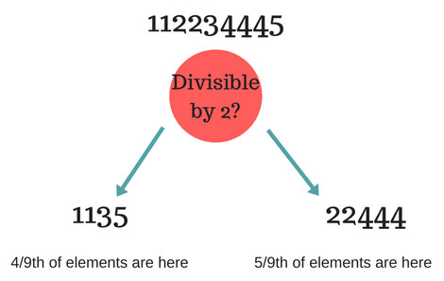
Supervised Machine Learning
Decision Tree:
Information Gain:
Information Gain (n) =
Entropy(x) — ([weighted average] *entropy(children for feature))
Entropy at root level : 0.66
Entropy of left child : 0.45 ,
weighted value = (4/9) * 0.45 = 0.2
Entropy of right child: 0.29 ,
weighted value = (5/9) * 0.29 = 0.16
Information Gain = 0.66 - [0.2 + 0.16] = 0.3
Decision tree at every stage selects the one that gives best information gain. When information gain is 0 means the feature does not divide the working set at all

Slide 44
Supervised Machine Learning
Example:

Slide 45
Supervised Machine Learning
Decision Tree:
We have outcomes at beginning as NNYYYNYN (Y = Yes and N = No) taken in given order. Entropy at this root node is 0.3
Now try to divide on various predictors outlook, temperature, humidity and Windy.
Calculate the information gain in each case. Which one has highest information gain?
For example, if we divide based on Outlook, we have divisions as
Rainy : NNN (entropy = 0)
Sunny : YYN (entropy = 0.041)
Overcast : YY (entropy = 0)
So information gain = 0.3 - [0 + (3/8)*0.041 + 0] = 0.28

Slide 46
Supervised Machine Learning
Decision Tree:
The information gain is max when divided based on Outlook.
Now the impurity for Rainy and Overcast is 0. We stop for them here.
Next we need to separate Sunny,
If we divide by Windy, we get max information gain.
Sunny
YYN
Windy? Yes : N
No : YY
So decision tree look like something as shown in image below.
No the prediction data is
Outlook : Rainy, Temperature: Cool, Humidity: High, Windy: False
Flowing down from tree according to result, we first check Rainy?
So answer is No, we don't play golf.

Slide 47
Supervised Machine Learning
Decision Tree:
End

Slide 48
Supervised Machine Learning
Model Persistence :
import pickle
from sklearn import svm
from sklearn import datasets
clf = svm.SVC()
iris = datasets.load_iris()
X, y = iris.data, iris.target
clf.fit(X, y)
s = pickle.dumps(clf)
clf2 = pickle.loads(s)
clf2.predict(X[0:1])
from sklearn.externals import joblib
joblib.dump(clf, 'filename.pkl')
clf = joblib.load('filename.pkl')

Slide 49
Supervised Machine Learning
PARAMETRIC and NONPARAMETRIC Machine Learning Algorithms
Parametric Machine Learning Algorithms
Algorithms that simplify the target mapping function to a known form are called parametric machine learning algorithms.
Examples
Linear Regression
Logistic Regression
Linear Discriminant Analysis
Perceptron
Naive Bayes
Simple Neural Networks

Slide 50
Supervised Machine Learning
Parametric Machine Learning Algorithms
Benefits of Parametric Machine Learning Algorithms:
  Simpler: These methods are easier to understand and interpret results.
  Speed: Parametric models are very fast to learn from data.
  Less Data: They do not require as much training data and can work well even if the fit to the data is not perfect.
Limitations of Parametric Machine Learning Algorithms:
  Constrained: By choosing a functional form these methods are highly constrained to the specified form.
  Limited Complexity: The methods are more suited to simpler problems.
  Poor Fit: In practice the methods are unlikely to match the underlying mapping function.

Slide 51
Supervised Machine Learning
Nonparametric Machine Learning Algorithms
Algorithms that do not make strong assumptions about the form of the mapping function are called nonparametric machine learning algorithms. By not making assumptions, they are free to learn any functional form from the training data.
Examples
k-Nearest Neighbors
Decision Trees like CART and C4.5
Support Vector Machines

Slide 52
Supervised Machine Learning
Nonparametric Machine Learning Algorithms
Benefits of Nonparametric Machine Learning Algorithms:
  Flexibility: Capable of fitting a large number of functional forms.
  Power: No assumptions (or weak assumptions) about the underlying function.
  Performance: Can result in higher performance models for prediction.
  Limitations of Nonparametric Machine Learning Algorithms:
  More data: Require a lot more training data to estimate the mapping function.
  Slower: A lot slower to train as they often have far more parameters to train.
  Overfitting: More of a risk to overfit the training data and it is harder to explain why specific predictions are made.

Slide 53
Supervised Machine Learning
Bias and Variation Errors:
Bias Error
Bias are the simplifying assumptions made by a model to make the target function easier to learn.
Generally, parametric algorithms have a high bias making them fast to learn and easier to understand but generally less flexible. In turn, they have lower predictive performance on complex problems that fail to meet the simplifying assumptions of the algorithms bias.
Low Bias: Suggests less assumptions about the form of the target function.
High-Bias: Suggests more assumptions about the form of the target function.
Examples of low-bias machine learning algorithms include:
Decision Trees, k-Nearest Neighbors and Support Vector Machines.
Examples of high-bias machine learning algorithms include: Linear Regression, Linear Discriminant Analysis and Logistic Regression.

Slide 54
Supervised Machine Learning
Variance Error
Variance is the amount that the estimate of the target function will change if different training data was used.
Generally, nonparametric machine learning algorithms that have a lot of flexibility have a high variance.
Low Variance: Suggests small changes to the estimate of the target function with changes to the training dataset.
High Variance: Suggests large changes to the estimate of the target function with changes to the training dataset.
Examples of low-variance machine learning algorithms include:
Linear Regression, Linear Discriminant Analysis and Logistic Regression.
Examples of high-variance machine learning algorithms include:
Decision Trees, k-Nearest Neighbors and Support Vector Machines.

Slide 55
Supervised Machine Learning
Bias and Variance:
Parametric or linear machine learning algorithms often have a high bias but a low variance.
Non-parametric or non-linear machine learning algorithms often have a low bias but a high variance.

Slide 56
End

Slide 57
Supervised Machine Learning

Slide 58
End

