Slide 1
AUTOMATA THEORY III

Slide 2
Automata Theory III
Languages And Regular Expressions
= { 0,1 }
L⁰,L¹, L², L³, …………L^{n}
L* = L⁰ ∪ L¹ ∪ L² ∪ L³ ∪ ……… ∪ L^{n}
Construction of FA’s for given languages

Slide 3
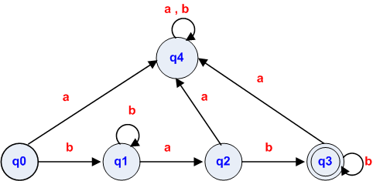
Automata Theory III
Σ = {a, b }
L = {w | b^{m} ab^{n} : m, n>0}

Slide 4
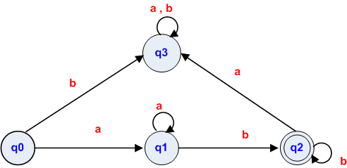
Automata Theory III
Σ = {a, b }
L = {w | a^{m} b^{n} : m, n>0}

Slide 5
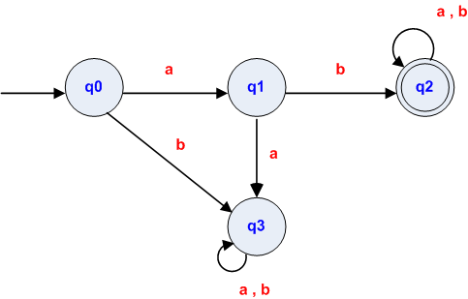
Automata Theory III
Σ = {a, b }
L={ w| all strings with the prefix ‘ab’ on Σ

Slide 6
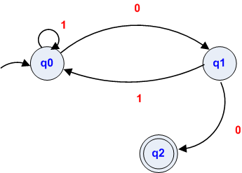
Automata Theory III
Σ = {0, 1}
L={0,1}* , having even number of 0’s

Slide 7
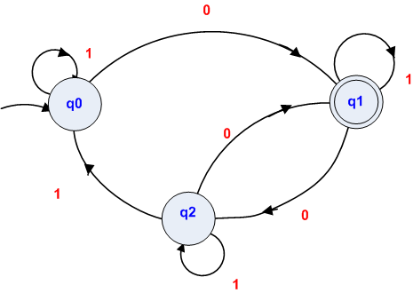
Automata Theory III
Σ = {0, 1}
L={w∈ {0,1}* | having odd number of 0’s}

Slide 8
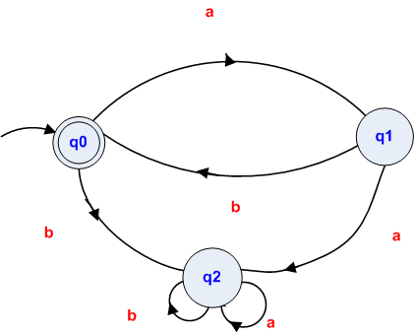
Automata Theory III
Σ = {a, b }
L={ (ab)*| n≥0 }, ε not accepted.

Slide 9
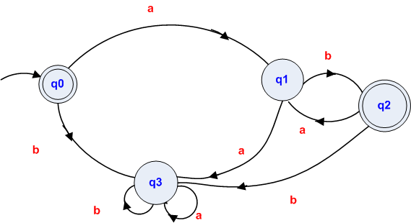
Automata Theory III
Σ = {a, b }
L={ (ab)*| n≥1 }, ε not accepted.

Slide 10
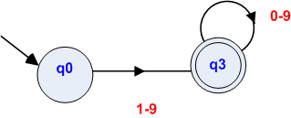
Automata Theory III
Σ = {0,1,… 9}
L= set of all integers

Slide 11
Automata Theory III
Σ = {+,-,0,1,… 9}
L= set of all signed integers

Slide 12
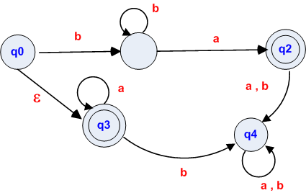
Automata Theory III
Σ = {a, b }
L={ a^{n}| n≥0 } ∪ { b^{n}a | n≥ 1}

Slide 13
Automata Theory III
Regular Expressions ( Regex )
A regular expression, often called a pattern, is an expression that describes a set of strings. They are usually used to give a concise description of a set, without having to list all elements.
Searching and Validation
Wild Cards
Computer Languages
Java:
import java.util.regex.*;
‘Pattern’ and ‘Matcher’ classes
C#:
using System.Text.RegularExpressions;
‘Regex’ class
C++, VB, Perl, Html, Oracle etc………….
3) Operating Systems
Unix, Linux, Windows, etc. (grep, ed, awk, vi, expr)

Slide 14
Automata Theory III
Examples of Regular Expressions:
Email Address:
\b[A-Z0-9._%+-]+@[A-Z0-9.-]+\.[A-Z]{2,4}\b
2) IP Address:
\b(25[0-5]|2[0-4][0-9]|[01]?[0-9][0-9]?)\.(25[0-5]|2[0- 4][0-9]|[01]?[0-9][0-9]?)\.(25[0-5]|2[0-4][0-9]|[01]?[0- 9][0-9]?)\.(25[0-5]|2[0-4][0-9]|[01]?[0-9][0-9]?)\b
3) Valid Date:
(19|20)\d\d[- /.](0[1-9]|1[012])[- /.](0[1-9]|[12][0-9]|3[01])
4) Visa Card:
^4[0-9]{12}(?:[0-9]{3})?$
5) Master Card:
^5[1-5][0-9]{14}$
Strings:
"[^"\r\n]*"
Numbers:
\b\d+\b, \b0[xX][0-9a-fA-F]+\b, (\b[0-9]+\.([0-9]+\b)?|\.[0-9]+\b)

Slide 15
Automata Theory III
Representation of Regular Expressions
It is obtained from a set of symbols Σ, empty string ε, null set Φ, performing operations, union(+), concatenation(.), and Kleene star(*).
Regular Expression defines Regular Languages as automata do.
L(E) is a language defined by regular expression ‘E’
BASIS:
1) ε and Φ are regular expressions, L(ε)={ε} and
L(Φ) ={Φ} are corresponding regular Languages.
2) ‘a’ is a symbol, then a is a regular expression and
L(a) ={a} is corresponding regular language.

Slide 16
Automata Theory III
INDUCTION:
Precedence of Regular Expression Operators:
1) *
2) .
3) +

Slide 17
Automata Theory III
If P, Q and R are regular expressions; then
R + R = R
Φ + R = R
ΦR = RΦ = Φ
εR = Rε = R
R* = ε + R + R2 + R3 + R4 + R5 + . . . . . .
(PQ)R = P(QR)
PQ ≠ QP
8) P (Q + R) = PQ + PR
9) (P + R)Q = PQ + RQ
10) R*R* = R*
11) RR* = R*R
12) (R*)* = R*
13) (P + Q)* = (P*Q*)* = (P* + Q*)*

Slide 18
Automata Theory III
Examples:
0 + 1
1
0
(0 + 1)1
(a + b).(b + c)
(0+1)*
(0+1)⁺
(ε + 1)(01)*(ε + 0)

Slide 19
Automata Theory III
SET
Regular Expression
1) { ^, ab }
2) {1,11,111, ….. }
3) Set of all strings over {a,b}
beginning and ending with ‘a’
{b², b⁵, b⁸, ……. }
{a^{2n+1}| n≥0}
{a^{2n}b^{2m+1}| n≥0}
Strings over {a,b} beginning
with 0 and ending with 1
^ + ab
1(1)*
a (a + b)*a
bb(bbb)*
a (aa)*
(aa)*(bb)*b
0 (0 + 1)*1

Slide 20
Automata Theory III
Def.:
If Σ is set of alphabet:
1) Φ is a regular language
2) For each a ∈ Σ, {a} is a regular language
3) If L⁰, L¹, L², L³, …….. L^{n} are regular languages then
L⁰∪ L¹∪ L²∪ L³ …….∪ L^{n} is also regular language.
4) If L⁰, L¹, L², L³, …….. L^{n} are regular languages then
L⁰ . L¹ . L² . L³ ……. . L^{n} is also regular language.
5) If L is a regular language, then so is L*.

Slide 21
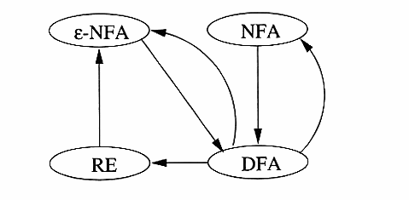
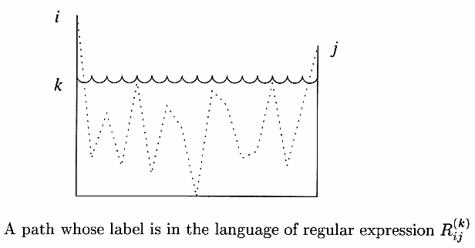
Automata Theory III
Finite Automata and Regular Expressions

Slide 22
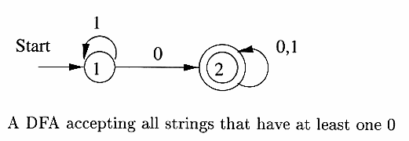
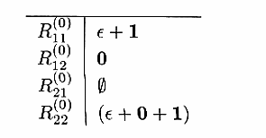
Automata Theory III
From DFA To Regular Expressions

Slide 23
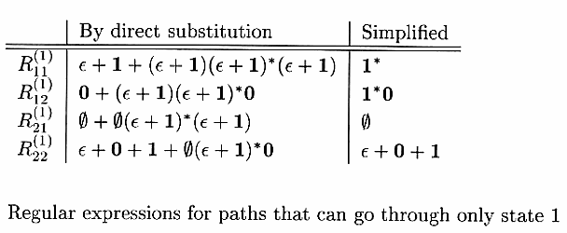
Automata Theory III

Slide 24
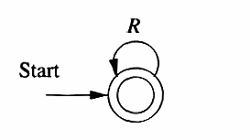
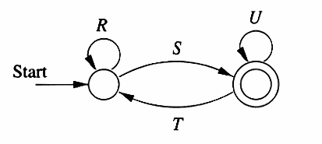
Automata Theory III
Converting DFA to Regular Expressions
by Eliminating States
A generic one-state Automaton
A generic two-state Automaton

Slide 25
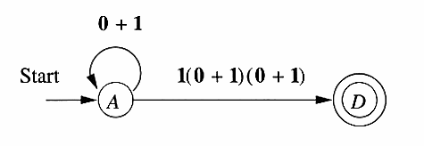
Automata Theory III
Eliminating
B and C

Slide 26
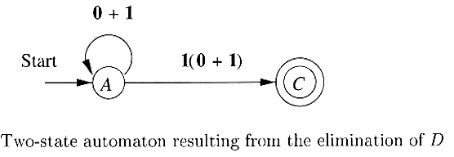
Automata Theory III

Slide 27
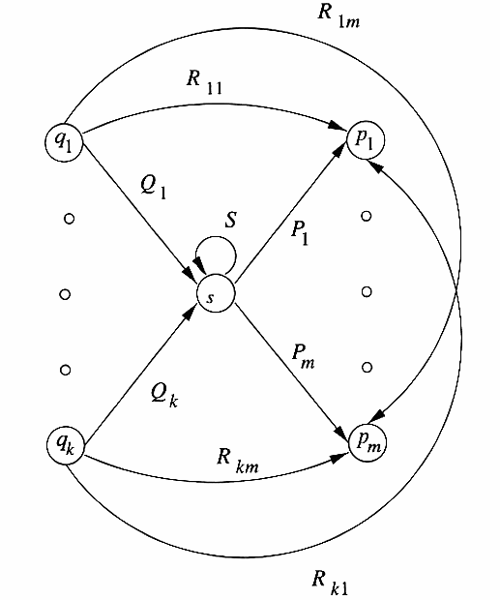
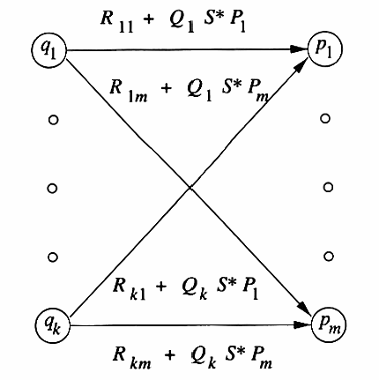
Automata Theory III

Slide 28
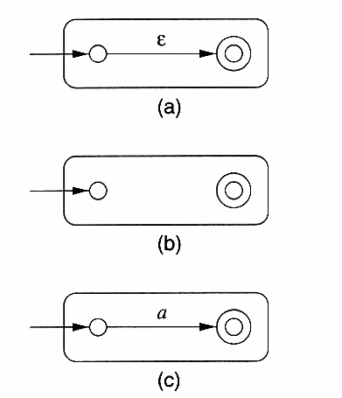
Automata Theory III
ε- NFA
L(ε) = {ε}
L(Ф) = Ф
L(a) = {a}

Slide 29
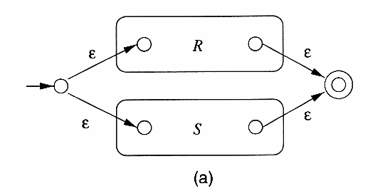
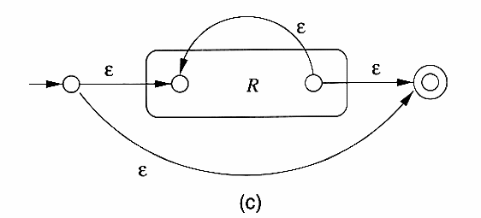
Automata Theory III
L = L(R) ∪ L(S)
L = L(R)L(S)
L = L(R*)

Slide 30
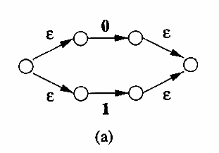
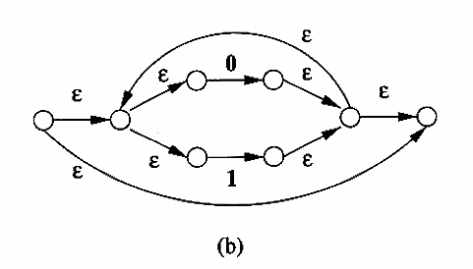
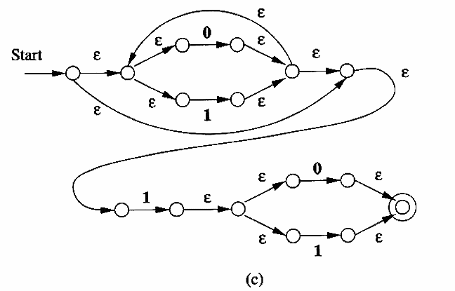
Automata Theory III
Conversion of Regular Expression (0 + 1)*1(0 + 1) to ε- NFA

Slide 31
Automata Theory III
Regular Expressions (Chapter 3 )
THE END

