Slide 1
AUTOMATA THEORY
II

Slide 2
Automata Theory II
1. Defs.
a) Finite Automaton:
A Finite Automaton ( FA ) has finite set of ‘states’ ( Q={q_{0,} q_{1,} q_{2,} ….. ) and its ‘control’ moves from state to state in response to external ‘inputs’(Σ = {a, b, c,…. }).
b) Deterministic Finite Automata ( DFA )
It consists of a finite set of states (Q), a finite set of input symbols (Σ), a transition function (δ(q_{i} , a ) = q_{j}), a start state (q₀) and a set final or accepting states (F ⊆ Q). Briefly a DFA ‘A’ = ( Q, Σ, δ, q₀, F )

Slide 3
Automata Theory II
b) Nondeterministic Finite Automata (NFA)
It consists of a finite set of states (Q), a finite set of input symbols (Σ), a transition function (δ(q , a ) = {…}⊆ Q ), a start state (q₀) and a set final or accepting state or states (F ⊆ Q).
Briefly NFA ‘A’ = ( Q, Σ, δ, q₀, F )
c) Language of Finite Automata ( L )
The set of all strings accepted by an Automaton.

Slide 4
Automata Theory II
Deterministic Finite Automata
Transition Diagram (State Diagram)
DFA A = ( {q₀, q₁, q₂ }, {0,1}, δ, q_{0 ,} q₁ )
Transition Diagram of a DFA that accepts all and only the strings of 0’s and 1’s that have the sequence 01 somewhere in the string.
Language of DFA :
L = {x01y | x and y are any strings of 0’s and 1’s }.
Circles represent states, double circle represents final state and arrows represent transitions showing input. Start arrow points to start state.

Slide 5
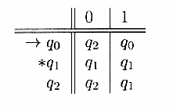
Automata Theory II
Transition Table.
DFA A = ( {q₀, q₁, q₂ }, {0,1}, δ, q_{0 ,} q₁ )with the same definition as in the last slide.
Rows of the table correspond to the states and columns correspond to inputs. The start state is marked with an arrow and the accepting states are marked with a star

Slide 6
Automata Theory
Example 1.
Given a Transition Table , draw a Transition diagram as DFA A = ( {q₁, q₂, q₃ }, {0,1}, δ, q_{1 ,} q₂ )
δ | 0 | 1
→q₁ | q₁ | q₂
*q₂ | q₃ | q₂
q₃ | q₂ | q₂
L(A) = {w|w contains at least one 1 and an even number 0f 0,s follow the last 1}

Slide 7
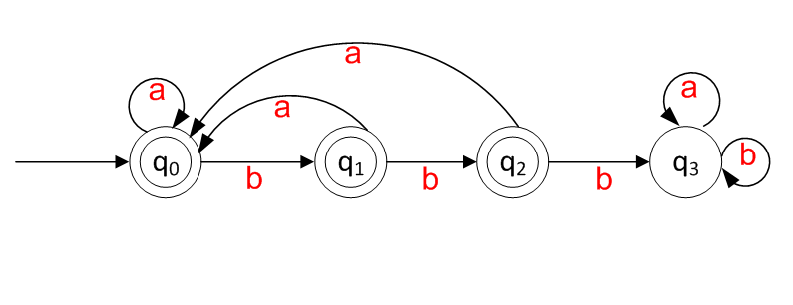
Automata Theory II
Example 2:
Design a DFA , A, which accepts the language
L(A) = { w ∈ (a,b)* : w does not contain three consecutive b’s}. Draw a Transition Table and Transition Diagram
Transition Table
Transition Diagram
δ | a | b
*q₀ | q₀ | q₁
*q₁ | q₀ | q₂
*q₂ | q₀ | q₃
q₃ | q₃ | q₃

Slide 8
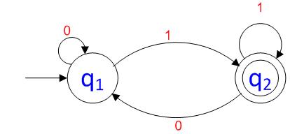
Automata Theory
Example 3:
Data for a DFA (A) :
Q={q1, q2}, Σ={0,1}, Initial state = q1, Final state = q2 and δ is given as under:
δ(q1,0) = q1, δ(q1,1) = q2, δ(q2,0) = q1, δ(q2,1) = q2
Determine a Language L(A) that the DFA recognizes
L(A) = {w| w ends in a 1}

Slide 9
Automata Theory II
Example 4:
Design a DFA , the language recognized by the Automaton being:
L = { a^{n} b: n≥0 }

Slide 10
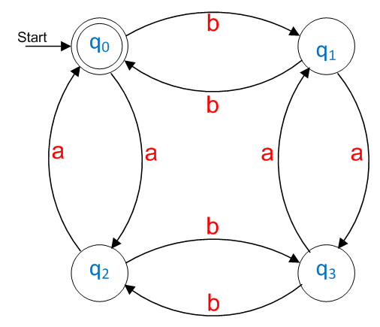
Automata Theory II
Example 5:
Obtain the state diagram and state transition diagram (DFA Schematic) of the finite state Automaton M=(Q, Σ, δ, q₀, F), where Q = {q₀, q₁, q₂, q₃, }, Σ = {a, b}, q₀ is the initial state , F is the final state with the transition defined by
δ(q₀, a) = q₂, δ(q₁, a) = q₃, δ(q₂, a) = q₀, δ(q₃, a) = q₁,
δ(q₀, b) = q₁, δ(q₁, b) = q₀, δ(q₂, b) = q₃, δ(q₃, b) = q₂
State Table Diagram
Transition
Diagram
δ | a | b
*q₀ | q₂ | q₁
q₁ | q₃ | q₀
q₂ | q₀ | q₃
q₃ | q₁ | q₀

Slide 11
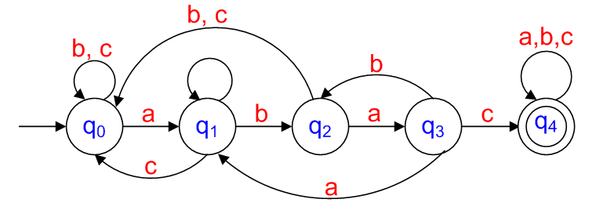
Automata Theory II
Example 6:
Obtain the DFA (A) that accepts/recognizes the language
L(A) = {w|w ∈ {a,b,c}* and w contains the pattern abac}

Slide 12
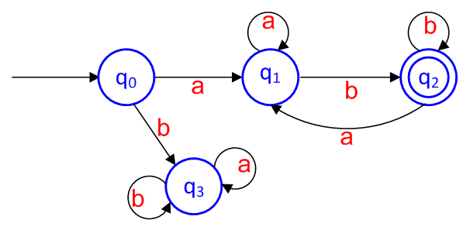
Automata Theory II
Example 7:
Obtain the DFA (A) that accepts/recognizes the language
L(A) = set of strings beginning with ‘a’ and ending with ‘b’

Slide 13
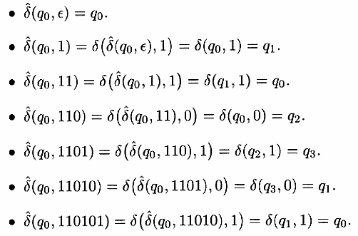
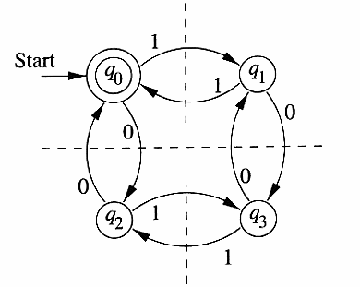
Automata Theory II
Language of a DFA
In Example 7, change Σ= {a, b} to Σ = {1,0}
The language of a DFA A= (Q, Σ, δ, q₀, F) is denoted L(A), and is defined by L(A) = { w| ̂δ (q₀, w) is in F }. If L is L(A) for some DFA A, then L is a Regular Language.

Slide 14
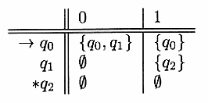
Automata Theory II
Non-deterministic Finite Automata
(NFA)
NFA is represented like a DFA A = (Q, Σ, δ, q₀, F), the difference between an NFA and a DFA is the value returned by transition function δ : a set of states in the case of an NFA and a single state in the case of a DFA.
Following NFA accepts all strings that end in 01

Slide 15
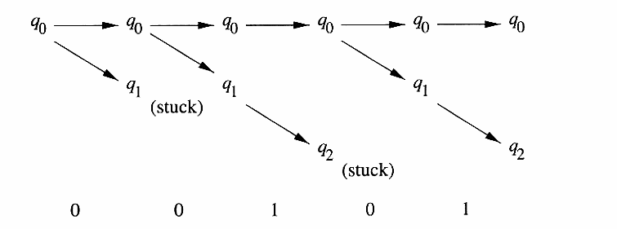
Automata Theory II

Slide 16
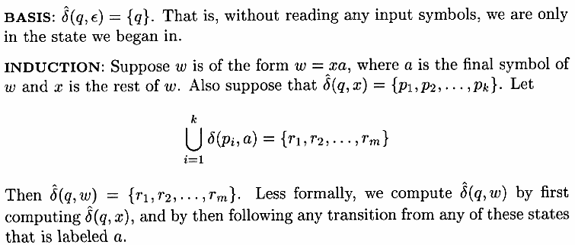
Automata Theory II
Extended
Transition
Function

Slide 17
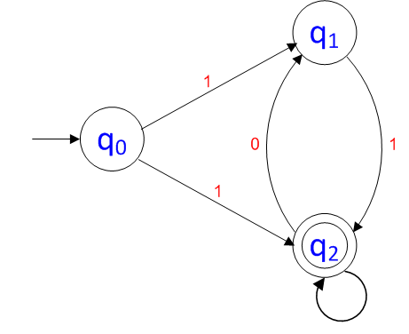
Automata Theory II
Example 8:
Determine an NFA accepting all strings over {0,1} which end in 1 but do not contain the substring 00.

Slide 18
Automata Theory II
Language of an NFA
If A= (Q, Σ, δ, q₀, F) is an NFA, then

Slide 19
Automata Theory II
Equivalence of Deterministic and Nondeterministic Finite Automata
Every language of an NFA can also be a language of a DFA.
DFA has as many states as NFA although it may have more transitions.
The smallest DFA can have 2^{n} states while the smallest NFA for the same language has only n states.
DFA can do whatever NFA can do.
A DFA can be constructed from an NFA by subset construction.

Slide 20
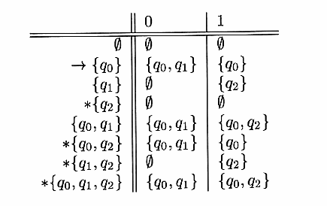
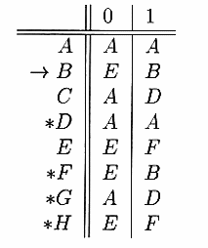
Automata Theory II
Subset Construction

Slide 21
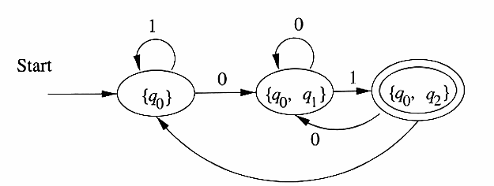
Automata Theory II
DFA constructed from NFA

Slide 22
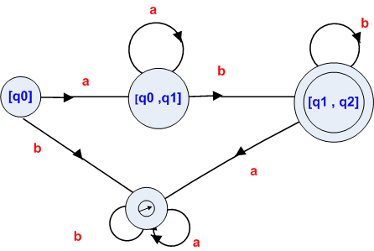
Automata Theory II
NFA
DFA

Slide 23
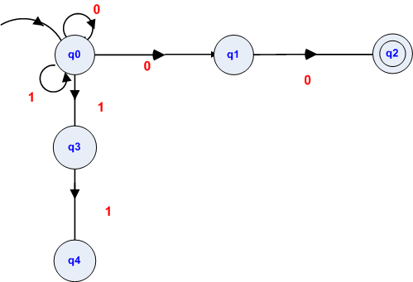
Automata Theory II
NFA

Slide 24
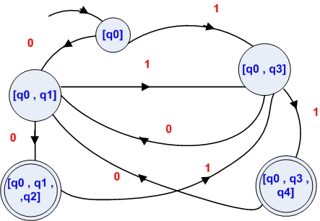
Automata Theory II
DFA

Slide 25
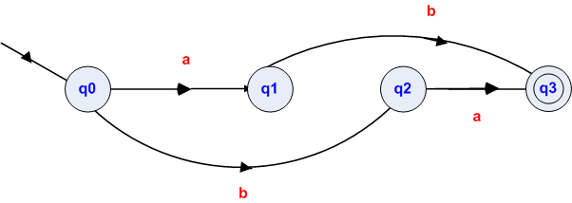
Automata Theory II
NFA

Slide 26
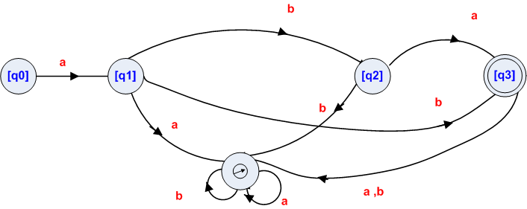
Automata Theory II
DFA

Slide 27
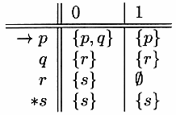
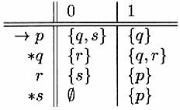
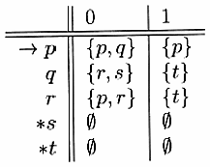
Automata Theory II
Convert the following NFA’s to DFA’s
1)
2)
2)
3)

Slide 28
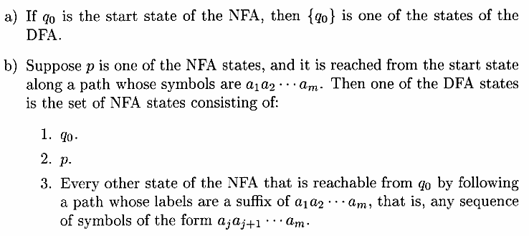
Automata Theory II
Text Search
Conditions

Slide 29
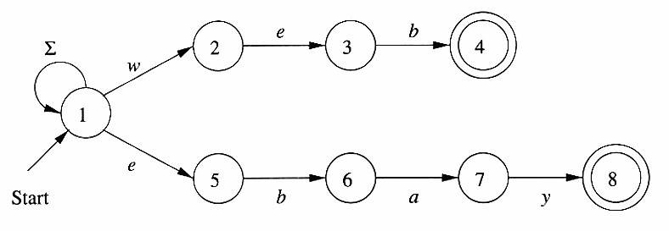
Automata Theory II
Text Search for two strings “web” and “ebay”. Σ stands for all ASCII characters.
NFA

Slide 30
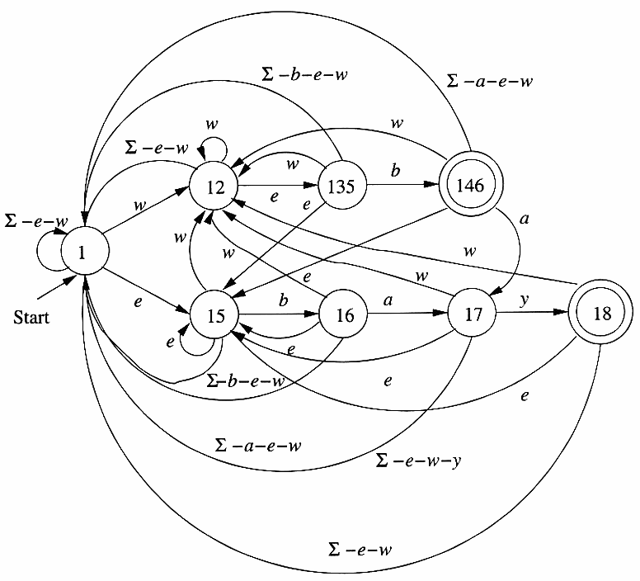
Automata Theory II
DFA

Slide 31
Automata Theory II
Finite Automata With Epsilon(Lambda) Transitions
An ε-NFA A= (Q, Σ, δ, q_{0,} F ), where δ = Q x (Σ ∪ ε ) accepts decimal numbers consisting of:
An optional + or – sign,
A string of digits,
A decimal point, and
Another string of digits. Either of the strings can be empty, but not both.
ε-NFA A is formally represented as
A = ( {q₀, q₁, ……. q₅ }, { +, -, ., 0, 1, …… 9 },δ, q₀ , {q₅ })

Slide 32
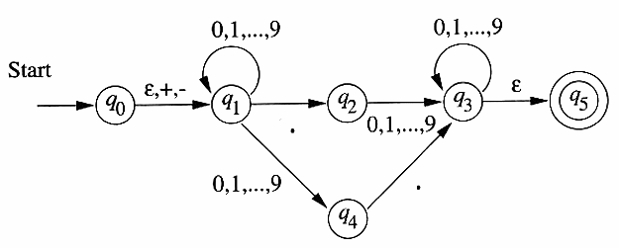
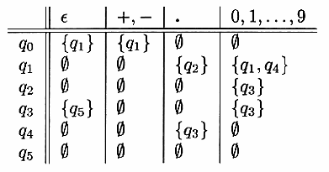
Automata Theory II
ε-NFA

Slide 33
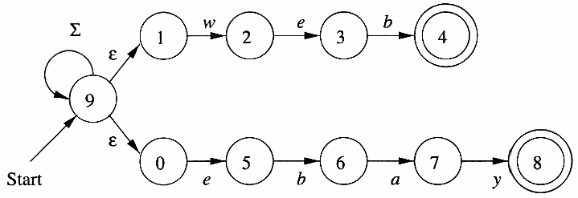
Automata Theory II
NFA
ε-NFA

Slide 34
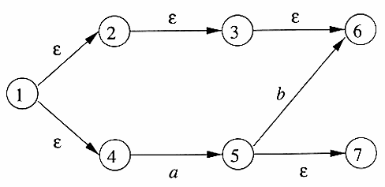
Automata Theory II
ε-Closures
ECLOSE(1) = {1, 2, 3, 4, 6}

Slide 35
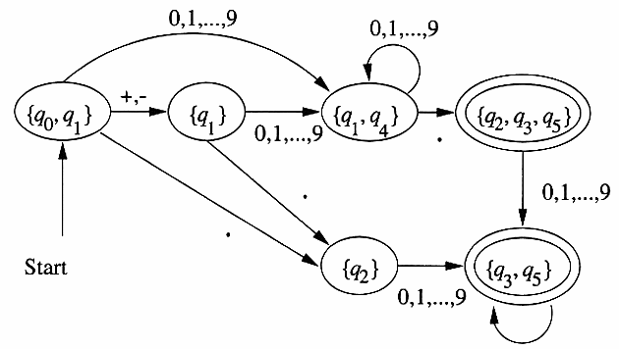
Automata Theory II
Eliminating
ε-Transitions
ε-NFA
DFA

Slide 36
Automata Theory II
End of Chapter 2

