Slide 1
Multimedia
011101110010000100101101000110111111
111000011101010100110001110101010101
100001110111111100001010101011110000
000001110101010101011111100000000111
001111101100110001100010111101010010
Prof. Muhammad Saeed

Slide 2
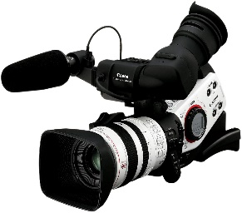
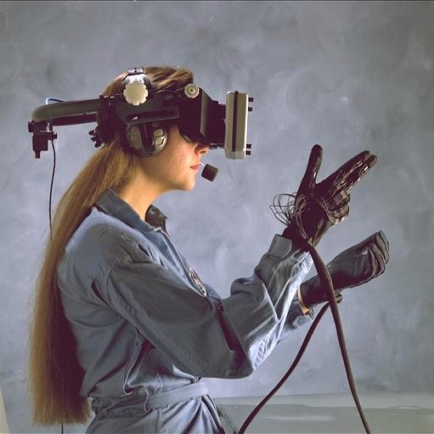
Multimedia
What is multimedia ?
Audio
Still Images
Video
Graphics
Text
“There are no tales finer than those created by life itself.”
Animation
Video
Virtual Reality

Slide 3
Multimedia
Multimedia is the field concerned with the computer-controlled integration of text, graphics, drawings, still and moving images (Video), animation, audio, and any other media where every type of information can be represented, stored, transmitted and processed digitally.

Slide 4
Applications
World Wide Web
Hypermedia
Video conferencing
Video-on-demand
Interactive TV
Groupware
Home shopping
Games
Virtual reality
Digital video editing and production systems
Multimedia Database systems

Slide 5
History
First printing press was invented by Johannes Gutenberg around 1440.
First newspaper was introduced in Venice, Italy in 1566.
First primitive radio transmitter was built by H. Hertz in 1887.
In 1895 Guglielmo Marconi sent his first wireless radio transmission at Pontecchio Italy.
Silent feature films started appearing from 1910.
1927 was the year talking movies appeared on the stage.
Animated short film directed by Walt Disney was screened in 1928.
First electronic computer appeared in April 1952.
In 1972 first commercial video game was released.
In 1980 IBM introduced desktop personal computer
CD’s appeared in the market in Oct. 1982.
Tim Berners-Lee invented the World Wide Web in 1989.
In 1991 PDA was introduced.

Slide 6
History
MPEG-1 was approved as an international standard for video.
JPEG was accepted as the international standard for digital image compression.
In 1992 first audio multicast on the net was made.
In 1993 full-fledged browser was launched.
In 1995 JAVA language was created.
In 1996 DVD video was introduced.
In 1998 XML 1.0 was announced.
In 1998 handheld MP3 devices holding 32 MB memory appeared in the market.
Flash drives commercially were available from 2000.
Facebook was launched in Feb. 2004.
YouTube was launched in Feb. 2005.
Twitter launched in March 2006.

Slide 7
Application Fields
There are a number of fields where multimedia is used.
Education & Training
Business
Entertainment
Visual Information Systems
Home
Public Places

Slide 8
Linear and Non-Linear
Linear:
A Multimedia Project is identified as Linear when:
It is not interactive
User have no control over the content that is being shown.
Example:
A movie
A non-interactive lecture / demo show

Slide 9
Linear and Non-Linear
Non-Linear:
A Multimedia Project is identified as Non-Linear when:
It is interactive
Users have control over the content that is being showed to them.
Users are given navigational control
Example:
Games
Courseware
Interactive CD

Slide 10
Multimedia
The End

