Slide 1
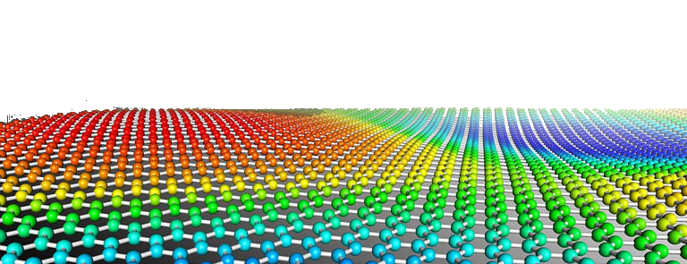
PYTHON
Prof. Muhammad Saeed

Slide 2
Solution Of Equations
&
Curve Fitting
Python Dept. Of Comp. Sc. & IT, FUUAST

Slide 3
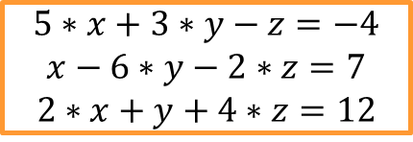
System of Linear Equations
$$5∗x+3∗y−z=−4$$
$$x−6∗y−2∗z=7$$
$$2∗x+y+4∗z=12$$
Method 1.
import numpy as np
C = np.matrix([[5, 3, -1],[1,-6,-2],[2,1,4]])
D = np.mat([-4,7,12]).T
Ci = C.I
x, y, z = Ci*D
print(‘ x=‘,x, ’ y=‘,y, ‘ z=‘,z)
Python Dept. Of Comp. Sc. & IT, FUUAST

Slide 4
System of Linear Equations
$$5∗x+3∗y−z=−4$$
$$x−6∗y−2∗z=7$$
$$2∗x+y+4∗z=12$$
Method 2.
import numpy as np
ac = np.array([[5, 3, -1],[1,-6,-2],[2,1,4]])
ad = np.array([-4,7,12])
x, y, z = np.linalg.solve(ac, ad)
print(‘ x=‘,x, ’ y=‘,y, ‘ z=‘,z)
Python Dept. Of Comp. Sc. & IT, FUUAST

Slide 5
Curve Fitting Polynomials:
import numpy as np
import matplotlib.pyplot as plt
x = np.array([0.0, 1.0, 2.0, 3.0, 4.0, 5.0])
y = np.array([0.0, 0.8, 0.9, 0.1, -0.8, -1.0])
p,v = np.polyfit(x, y, 3,cov=True)
DATA:
d = [ 0.005, 0.009, 0.016, 0.025, 0.040, 0.062, 0.085, 0.110]
s = [205,150,135,97,89,80,70,67]
Python Dept. Of Comp. Sc. & IT, FUUAST

Slide 6
Curve Fitting Polynomials:
import numpy as np
import matplotlib.pyplot as plt
Import scipy as sp
x = [ 0.005, 0.009, 0.016, 0.025, 0.040, 0.062, 0.085, 0.110]
y = [205,150,135,97,89,80,70,67]
c=np.polyfit(x,y,3)
mn=np.min(x)
mx=np.max(x)
x1=np.linspace(mn,mx,500)
y1=np.polyval(c,x1) # f=sp.poly1d(c); y1=f(x1)
plt.plot(x,y,’ob’)
plt.plot(x1,y1,’-r’)
plt.show()
Python Dept. Of Comp. Sc. & IT, FUUAST

Slide 7
Curve Fitting Line Regression:
import numpy as np
import matplotlib.pyplot as plt
from scipy import stats
x = np.array([1.5,2,2.5,3,3.5,4,4.5,5,5.5,6])
y = np.array([10.35,12.3,13,14.0,16,17,18.2,20,20.7,22.5])
gradient, intercept, r_value, p_value, std_err = stats.linregress(x,y)
mn=np.min(x)
mx=np.max(x)
x1=np.linspace(mn,mx,500)
y1=gradient*x1+intercept
plt.plot(x,y,’ob’)
plt.plot(x1,y1,’-r’)
plt.show()
Python Dept. Of Comp. Sc. & IT, FUUAST

Slide 8
Curve Fitting
$$ae^{−bx}\sin\left(cx\right)$$
import numpy as np
from scipy.optimize import curve_fit
import matplotlib.pyplot as plt
x= np.linspace(-3.5,3.5,31)
y1=3.*np.exp(-0.7*x)*np.sin(2*x)
y=y1+1.0*np.random.normal(0,1,len(x))
fnc=lambda x,a,b,c: a*np.exp(-b*x)*np.sin(c*x)
p,d=curve_fit(fnc,x,y, bounds=(0,[4,4,4]))
print(p)
xf=np.linspace(-3.5,3.5,500)
yf=fnc(xf,p[0],p[1],p[2])
plt.plot(x,y,'bo')
plt.plot(xf,yf,'-r')
plt.show()
Python Dept. Of Comp. Sc. & IT, FUUAST

Slide 9
Data
Python Dept. Of Comp. Sc. & IT, FUUAST

Slide 10
Data
x1 = [0.0,0.2,0.4,0.6,0.8,1.0,1.2,1.4,1.6,1.8,2.0,2.2,2.4,2.6,2.8]
y1 =[25.0000,22.0420,18.4478,14.7561,11.4302,8.6954,6.5733,4.9793,
3.7960,2.9220,2.2737,1.7886,1.4226,1.1435, 0.9283]
d = [ 0.005, 0.009, 0.016, 0.025, 0.040, 0.062, 0.085, 0.110]
s = [205,150,135,97,89,80,70,67]
Python Dept. Of Comp. Sc. & IT, FUUAST

Slide 11
Functions User-defined
def evenodd(n):
if (n%2==0):
print(‘\nEven’)
else:
print(‘\nOdd’)
Lambda Function
f=lambda x, y: 2*x**2-3*x*y+5*y**2+4*x-2*y+10; f(2.5, 3)
nums = [2, 18, 9, 22, 17, 24, 8, 12, 27]
flt=(filter(lambda x: x % 3 == 0, nums)); print(*flt)
Vectorization
import numpy as np
def Magnitude(a,b):
return np.sqrt(a**2+b**2)
vecMag = np.vectorize(Magnitude)
c=vecMag([0,3,6,9],[1,3,5,7])
print(c)
$$2x^{2}−3xy+5y^{2}+4x−2y+10$$
Python Dept. Of Comp. Sc. & IT, FUUAST

Slide 12
Solution Of Eqns. Roots Of Polynomials
import numpy as np
from scipy.optimize import fsolve
cofs= np.array([2,-4,9,-2])
r=np.roots(cofs)
print(r)
f=lambda x: 2*x*np.sin(x)-3*x**2*np.cos(x)
c=fsolve(f,1)
print(c)
Python Dept. Of Comp. Sc. & IT, FUUAST

Slide 13
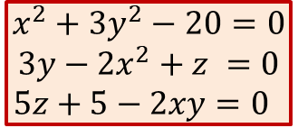
Solution Of Eqns. System Of Equations
import numpy as np
from scipy import fsolve
m = np.array([ [1,-2,-1], [2,2,-1], [-1,-1,2] ])
c = np.array([6,1,1])
y = np.linalg.solve(m, c)
print(y)
def myFunction(v):
x = v[0]
y = v[1]
z = v[2]
f = np.empty((3))
f[0] = x**2+3*y**2-20
f[1] = 3*y-2*x**2+z
f[2] = 5*z + 5 - 2*x*y
return f
guess =np. array([1,1,1])
fs = fsolve(myFunction, guess)
print(fs)
$$x^{2}+3y^{2}−20=0$$
$$3y−2x^{2}+z =0$$
$$5z+5−2xy=0$$
Python Dept. Of Comp. Sc. & IT, FUUAST

Slide 14
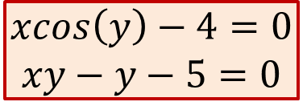
Solution Of Eqns. System Of Equations
$$xcos\left(y\right)−4=0$$
$$xy−y−5=0$$
from scipy.optimize import fsolve
def findRootFn1(x):
out = [x[0]*np.cos(x[1]) - 4]
out.append(x[1]*x[0] - x[1] - 5)
return out
x1,x2 = fsolve(findRootFn1, [1, 1])
print('Roots of two simultaneous equations: ',x1,x2)
Python Dept. Of Comp. Sc. & IT, FUUAST

Slide 15
Interpolation
Python Dept. Of Comp. Sc. & IT, FUUAST

Slide 16
Interpolation 1D
import numpy as np
from scipy import interpolate
x=np.arange(1:11)
y=np.array([9.4,7.31,5.15,3.55,2.81, 2.04,1.26, 0.97, 0.74, 0.58])
r=np.interp(3.8,x,y)
print(r)
v=np.array([6.9, 4.78, 2.1,1.0,0.81])
r=np.interp(v,x,y)
print(r)
x = np.arange(0, 10)
y = np.exp(-x/3.0)
fnc = interpolate.interp1d(x, y)
x2 = np.arange(0, 9, 0.5)
y2 = fnc(x2)
print(y2)
Python Dept. Of Comp. Sc. & IT, FUUAST

Slide 17
f = interpolate.interp1d(x, y, fill_value='extrapolate')
Interpolation 1D
import numpy as np
import scipy.interpolate as interpolate
Import matplotlib.pyplot as plt
x = np.arange(0, 10)
y = np.exp(-x/3.0)
fnc = interpolate.interp1d(x, y, fill_value='extrapolate‘,kind=‘cubic’)
fnc = interpolate.interp1d(x, y, kind=‘cubic’) # ‘linear’, ‘nearest’
x2 = np.arange(0, 9, 0.5)
y2 = fnc(x2)
print(y2)
x = np.linspace(0, 10, 11, endpoint=True)
y = np.cos(-x**2/9.0)
f = interpolate.interp1d(x, y)
f2 = interpolate.interp1d(x, y, kind='cubic')
f3 = interpolate.interp1d(x, y, kind=‘nearest')
xnew = np.linspace(0, 10, num=101, endpoint=True)
plt.plot(x, y, 'o', xnew, f(xnew), '-', xnew, f2(xnew), '--‘,xnew,f3(xnew),’:’)
plt.legend(['data', 'linear', 'cubic‘, ‘nearest’], loc='best')
Python Dept. Of Comp. Sc. & IT, FUUAST

Slide 18
Interpolation 2D
import numpy as np
import scipy.interpolate as interpolate
Import matplotlib.pyplot as plt
x = np.arange(-5.01, 5.01, 0.25)
y = np.arange(-5.01, 5.01, 0.25)
xx, yy = np.meshgrid(x, y)
z = np.sin(xx**2+yy**2)
f = interpolate.interp2d(x, y, z, kind='cubic')
xnew = np.arange(-5.01, 5.01, 1e-2)
ynew = np.arange(-5.01, 5.01, 1e-2)
znew = f(xnew, ynew)
plt.plot(x, z[0, :], 'ro-', xnew, znew[0, :], 'b-')
plt.show()
Python Dept. Of Comp. Sc. & IT, FUUAST

Slide 19
END
Python Dept. Of Comp. Sc. & IT, FUUAST

