Slide 1
AUTOMATA THEORY V

Slide 2
Automata Theory V
Context-Free Grammars
and
Languages

Slide 3
Automata Theory V
DEF.
A context-free language (CFL) is a formal language that can be defined by a context-free grammar (CFG) . The set of all context-free languages is identical to the set of languages accepted by pushdown automata.
The class of context-free languages generalizes the class of regular languages, i.e., every regular language is a context-free language.
The reverse of this is not true, i.e., every context-free language is not necessarily regular. For example, as we will see {0^{k}1^{k} | k>=0} is context-free but not regular.

Slide 4
Automata Theory V
Formally, a Context-Free Grammar (CFG) is a 4-tuple:
G = (V, T, P, S)
V - A finite set of variables or non-terminals
T - A finite set of terminals (V and T do not intersect)
P - A finite set of productions, each of the form A –> α, where A is in V and α is in (V U T)* , α may be ε
S - A starting non-terminal (S is in V)

Slide 5
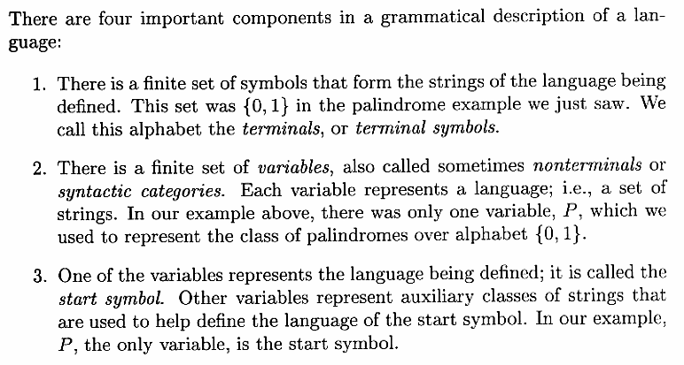
Automata Theory V
Definition of Context-Free Grammars

Slide 6
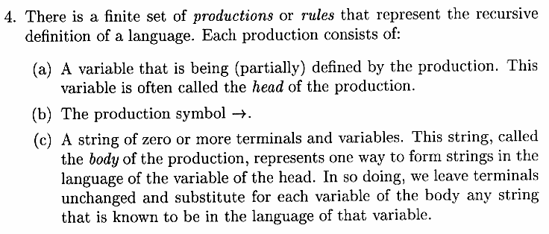
Automata Theory V
Definition of Context-Free Grammars ….. Continued
Grammar G = (V, T, P, S)

Slide 7
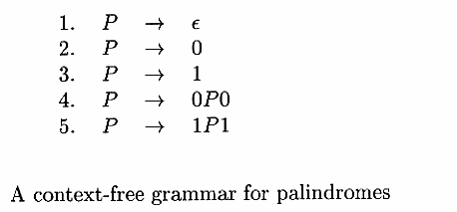
Automata Theory V
Example:
Palindrome
The grammar G_{pal} for the palindrome is represented by
G_{pal} = ( {P}, {0,1}, A, P ). A represents above productions

Slide 8
Automata Theory V
Context-Free Grammar G = (V, T, P, S)
Right-Linear Grammar
Productions forms:
V → T*V or
V → T*
Left-Linear Grammar
Productions forms:
V → VT* or
V → T*

Slide 9
Automata Theory V
Examples:
Grammar G = ({E,I}, T, P, E)
E = (a+b)(a+b+0+1)*
T = {+, *, (,), a, b, 0, 1}
Production Rules:
E → I
E → E + E
E → E * E
E → (E)
I → a
I → b
I → Ia
I → Ib
I → I0
I → I1
Derivations:

Slide 10
Automata Theory V
Grammar G = ( {S}, {a, b}, P, S)
Production Rules:
S → aSa
S → bSb
S → ε
Derivation:
S ⇒ aSa
⇒ aaSaa
⇒ aabSbaa
⇒ aabbaa

Slide 11
Automata Theory V
Leftmost Derivations
At each step of derivation we replace the leftmost variable by one of its production bodies
Grammar G = ( {S}, {a, b}, P, S)
Production Rules:
S → aSS
S → b
Derivation
S ⇒ aSS (Rule 1)
⇒ aaSSS (Rule 1)
⇒ aabSS (Rule 2)
⇒ aabaSSS (Rule 1)
⇒ aababSS (Rule 2)
⇒ aababbS (Rule 2)
⇒ aababbb (Rule 2)

Slide 12
Automata Theory V
Rightmost Derivations
At each step of derivation we replace the rightmost variable by one of its production bodies
Grammar G = ( {S}, {a, b}, P, S)
Production Rules:
S → aSS
S → b
Derivation
S ⇒ aSS (Rule 1)
⇒ aSb (Rule 2)
⇒ aaSSb (Rule 1)
⇒ aaSaSSb (Rule 1)
⇒ aaSaSbb (Rule 2)
⇒ aaSabbb (Rule 2)
⇒ aababbb (Rule 2)

Slide 13
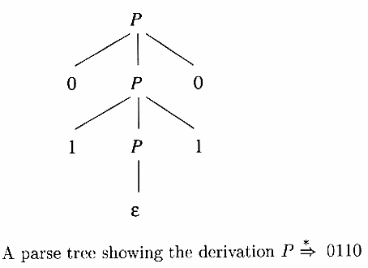
Automata Theory V
Sentential Forms
Strings produced by derivation from the start symbol are termed as ‘Sentential Forms’.
If the derivation is leftmost then the strings are left-sentential form.
If the derivation is rightmost then the strings are right-sentential form.
Derivation Trees or Parse Trees

Slide 14
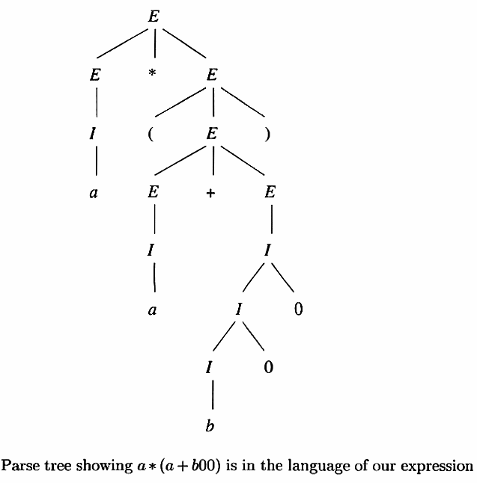
Automata Theory V
Derivations:

Slide 15
Automata Theory V
Given a CFG with production rules as:
S → aA
A → aB
B → bB
B → a
and productions as:
S ⇒ aA
⇒ aaB
⇒ aabB
⇒ aaba
Draw parse tree

Slide 16
Automata Theory V
Given a CFG with production rules as:
S → aAB
A → Bba
B → bB
B → c
and productions as:
S ⇒ aAB
⇒ a(Bba)B
⇒ acbaB
⇒ acba(bB)
⇒ acbabc
Draw parse tree

Slide 17
Automata Theory V
Given a CFG with production rules as:
S → aSb
S → ab
and productions as:
S ⇒ aSb
⇒ aaSbb
⇒ aaabbb
Draw parse tree

Slide 18
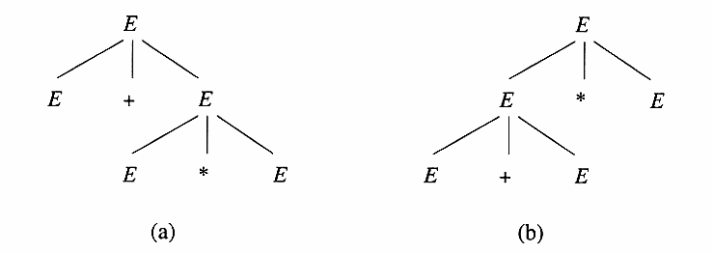
Automata Theory V
Ambiguity
Ambiguity can be removed by introducing operator precedence
Ambiguity can be reduced by allowing association or grouping from left or right

Slide 19
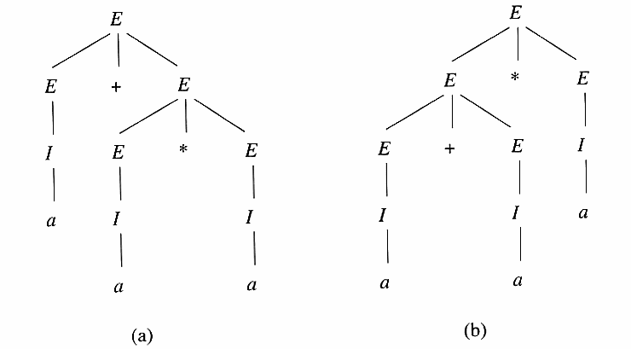
Automata Theory V
Ambiguity

Slide 20
Automata Theory V
Application of Context-Free Grammars
Compiler Parsers
HTML
XML

Slide 21
Automata Theory V
End of Chapter 5

